Slide 1

Zeus Project
Date: 9/25/2026
Zeus Development Group: Noah Schatz, Christina Walker, Diego Cummins, Jessy Peña , Jose Aguirre
Team Sponsor: Bret Van-Delden
Redefining Personal safety

Slide 2
Background/ Overview
The Problem
Schools rely on lockdown procedures
Limited defensive options
Existing options have safety/regulatory concerns
Response delays increase risk
Our solution
Portable, less lethal deterrent
Directional sound and strobe lighting
Simple activation
Provides additional time for law enforcement

Slide 3
Completed and Ongoing Tasks
Noah Schatz
Completed
Sound Code Setup
White Light Code Setup
Green Light Code Setup
Ongoing
Sound Code Testing
Sound Code Integration into Main File
Light Code Testing

Slide 4
Current Obstacles/ Solutions
Testing | We need to do more testing of the volume output at different rms wattages to fine tune the volume graph
Compatibility | A final microcontroller that isn’t an Arduino needs to be chosen so I can adapt my code for it.
Hardware | The electrical circuit needs to be finalized and created so I can adjust my pwm outputs to our desired output.

Slide 5
Next Steps
RMS Wattage
Integrate Sound Setup
Fine Tune Patterns
I want to adjust my volume output so that the average output is less than the rated RMS Wattage
I need to add the sound code to the main complete file once it has been tested and verified to work
More testing needs to be done to make sure the sound and light is as jarring as possible

Slide 6
Completed and Ongoing Tasks
Christina Walker
Completed
Sound Level Log
Light Pattern Log
Ongoing
Sound Level Management
Battery Indicator Chirp
Battery Indicator

Slide 7
Current Obstacles/ Solutions
Final System Parameters | Have yet to be fully determined, so placeholder values are being used
Multiple Subsystems Interacting | Piin assignments need to be consistently reviewed and adjusted
Battery Monitoring Hardware | Finalize and set threshold
Sound Safety Controls | Microphone feedback with speaker control circuit and set medical limits
Immediate vs Cumulative Response | Balancing an instant reaction to dangerous spikes against filtering out false positives for prolonged exposure tracking.
Data Loss vs. Logging Speed | Determining flush frequency that balances write reliability against SD card overhead, given the system's short runtime.

Slide 8
Next Steps
Finalize Safety Thresholds
Implement Hardware Control
System Testing
Determine actual dB limits (soundLimitDb, exposureLimitDb, maxExposureTime) through calibration testing and review, replacing current placeholder values
Replace the reduceSpeakerOutput() stub with real control logic once the amplifier/output circuit design is finalized.
Test consecutive reading and exposure timing logic under real conditions to confirm thresholds correctly distinguish sustained danger from brief spikes.

Slide 9
Completed and Ongoing Tasks
Jose Aguirre
Completed
LED Circuit
Speaker Circuit
Ongoing
LED & Speaker Testing
LED RIng Assembly
Schematic for PCB

Slide 10
Current Obstacles/ Solutions
LED & Speaker Testing | We already have a 3D printed LED ring in order to start testing the focal points of the LED to see what works best in a classroom environment.
LED Ring Assembly | Figure out a way to keep the LEDs on the ring.
Device Circuit ready for PCB layouting | Must implement new microcontroller in schematics for in order to start working on a PCB layout to send out PCB layout for the final product as soon as possible.

Slide 11
Next Steps
System Circuit schematic for PCB production
LED & Speaker Testing
LED Ring Assembly
I want to start testing the ring and focal points in order to start testing the effectiveness of the system.
Since we just 3D printed the front section, I have to figure out a way for the LEDs to stay put and implement it.
I must find the certain microcontroller in Altium, so that we can have the circuit ready to start working on the PCB.

Slide 12
Completed and Ongoing Tasks
Jessy Pena
Completed
LED Implementation
Temp Body CAD Model
Ongoing
Final Body CAD Model
PCB Design
Trigger mechanism

Slide 13
Current Obstacles/ Solutions
Permanent Microcontroller | Necessary to finalize housing of device & PCB design
Battery Indicator | Invest in a fuel gage to better measure the actual battery voltage
Trigger mechanism | Need to integrate properly into our device

Slide 14
Next Steps
Trigger
Clean up CAD
PCB Design
I want to get this done soon so it can be implemented with the rest of the circuit.
I need to create another model from scratch that is simpler and better fits our needs (battery, pcb, etc), though PCB can take different shapes
Create and order the PCB soon to start getting test values closer to our final product

Slide 15
Completed and Ongoing Tasks
Diego Cummins
Battery Management and implementation
Completed
LED Housing
Speaker Cone
Power requirements
Ongoing
Heat Dissipation
Battery
Battery Management

Slide 16
Current Obstacles/ Solutions
Heat Dissipation | We are using a mix of aluminum and plastic in order to help with heat. Aluminum will be used in high heat areas in order to allow for better dissipation
Battery | We switched from a battery pack to using individual cells to remove restrictions on size and allow for more modularity. With the use of cells we can now adjust as needed as we test the device.
Battery Management | Switching to individual cells requires a battery management system so we will use a BMS IC to put in safe guards for the battery.

Slide 17
Next Steps
Heat Dissipation
Battery
Battery Management System
I will test different heat sinks/ designs for the housing in particular since it will be closest to the heat source. I want to also try different material thicknesses.
I have currently been doing research on small battery packs with cells and will be choosing some to order.
I have been looking at different data sheet with BMS ICs and will be choosing one soon. It have to be complex as it will only be for about 10 cells and I plan to have it ready by the next demo.

Slide 18
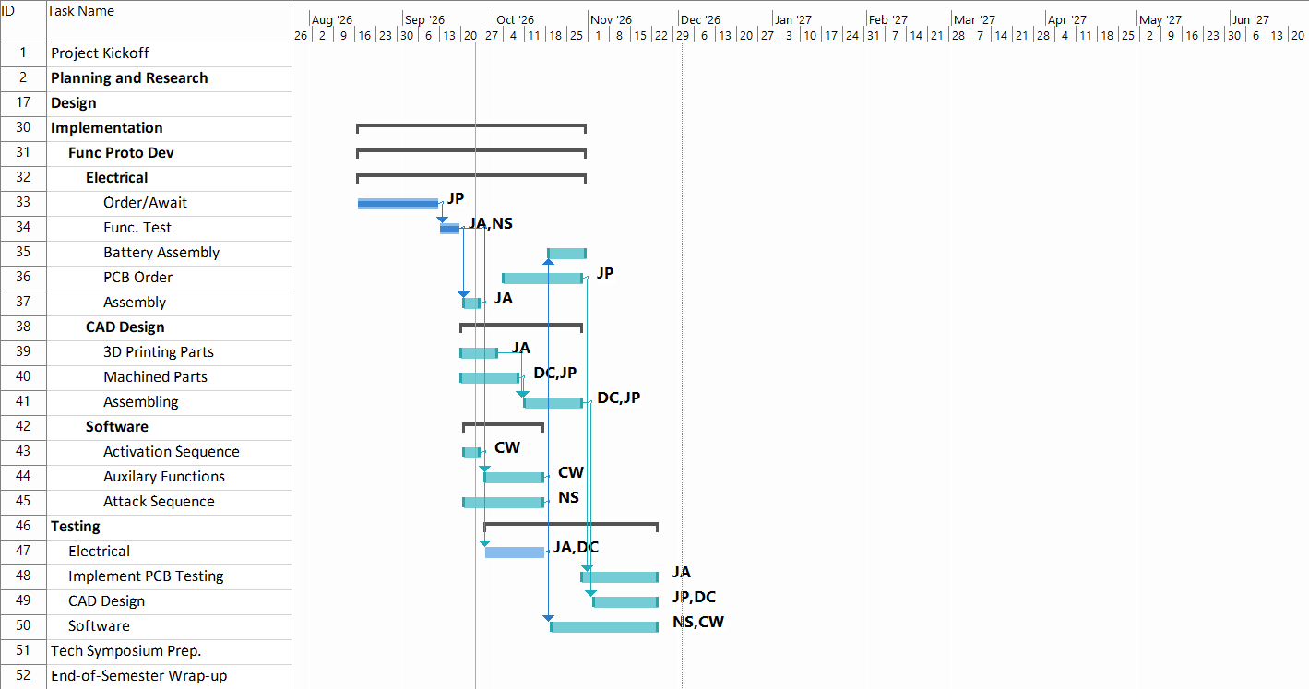
Work Breakdown Structure

Slide 19

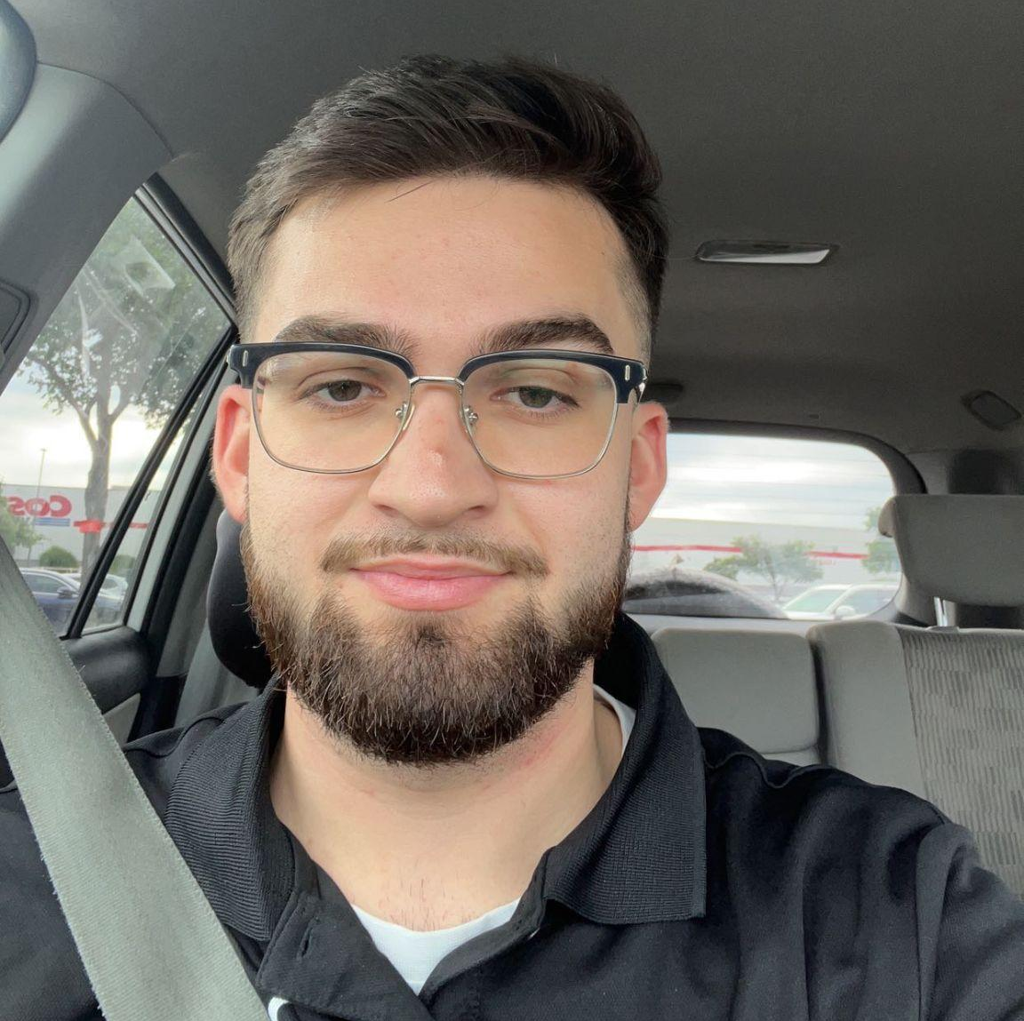

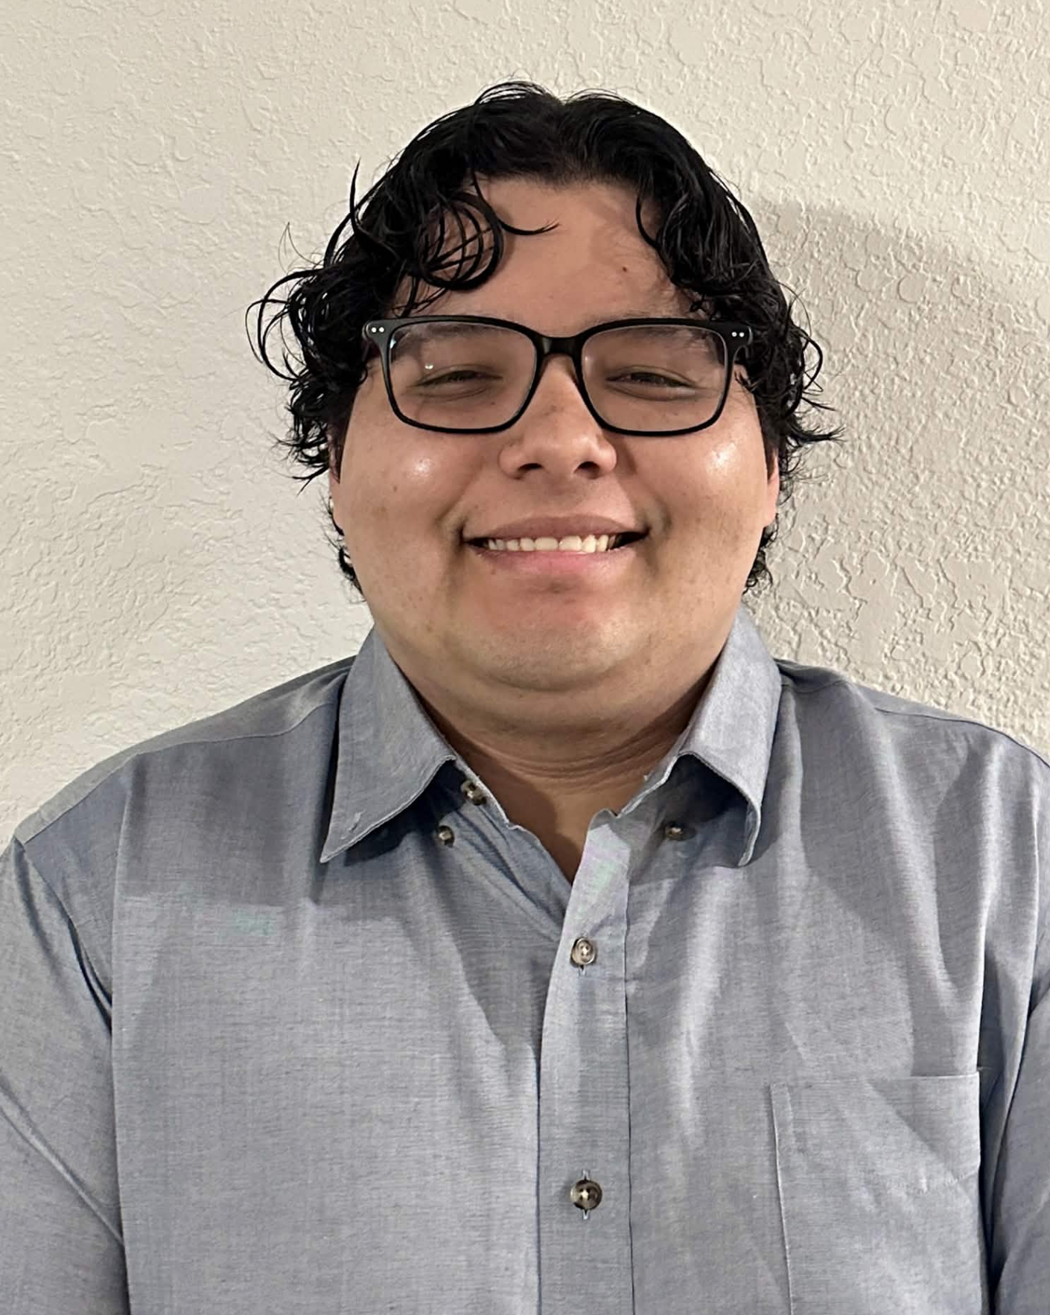
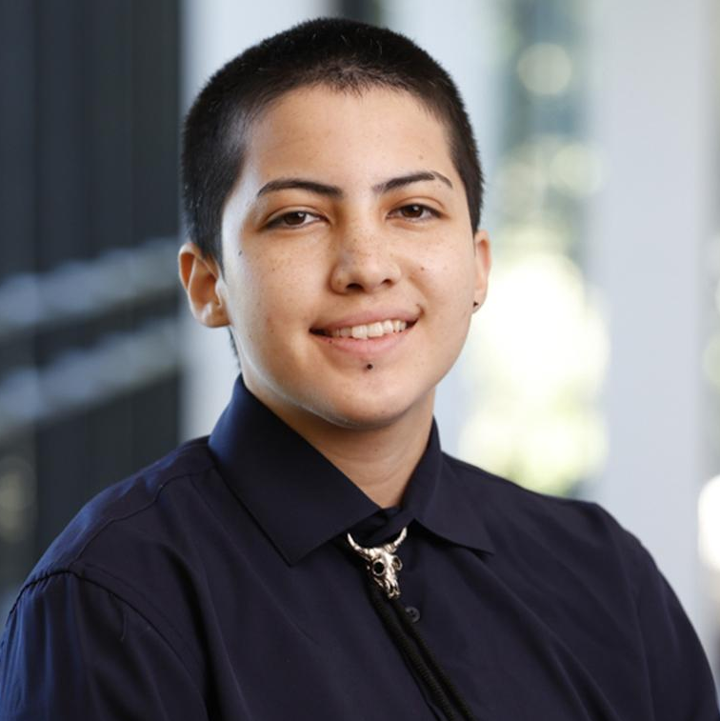
Biography
Christina Walker
Roles: Data Acquisition, Sensing, Control, Safety Engineer
Skills: C++, C, Python, PSpice, Altium
Diego Cummins
Roles: Power Engineer,
Head management, and device design
Skills: Solidworks, Autocad, PSIM
Noah Schatz
Roles: Control Systems Engineer,
Project Manager
Skills: C++, C, Verilog, Assembly, MATLAB, Altium, PSpice, CAD
Jose Aguirre
Roles: Hardware Engineer, Parts Manager, Procurement
Skills: Altium, Pspice, TinkerCAD, Circuit Design
Jessy Pena
Roles: Hardware Integration Engineer, Meeting Coordinator
Skills: Fusion360, PSpice, Blender, KiCAD, VS Code

